Slide 1

Project Work Break Down Structure
DATA ANALYSIS Absence of insights for the relationship between student's economic background, academic Performance, Competence & expected salary.
By:
Puram Raja Venkata Shandilya

Slide 2
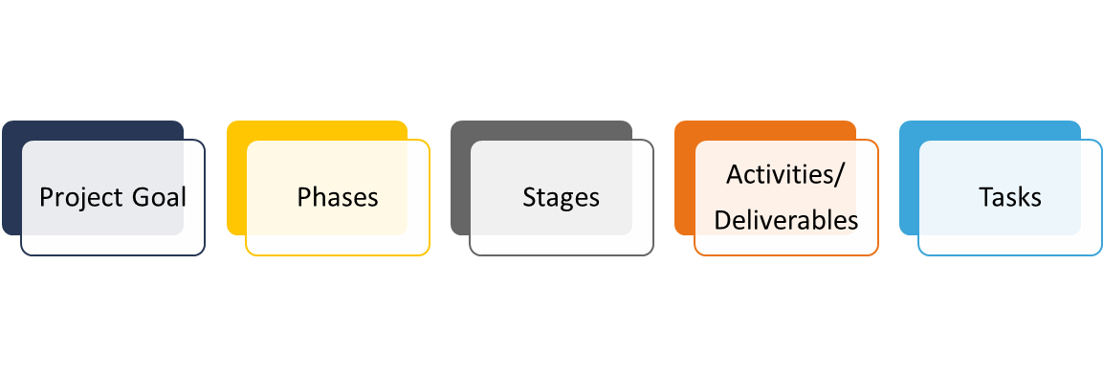
The goal of the project was to collect, clean, and analyze large datasets to generate insights for business decision-making, while creating automated reporting processes.
Key Contributions:
Data Collection and Cleaning: Handled large datasets, cleaned and pre-processed data using Python to remove inconsistencies and fill missing values.
Exploratory Data Analysis (EDA): Performed in-depth EDA to identify trends and patterns, ensuring actionable insights.
Dashboard Creation: Developed interactive dashboards using Power BI to visualize key performance indicators (KPIs).
Automation: Automated the generation of reports to streamline the analysis process and improve efficiency.
Tools Used: Python, Power BI, Excel.

Slide 3
Clean and preprocess data from multiple sources.
Perform exploratory data analysis (EDA) to derive meaningful insights.
Create an automated dashboard for real-time reporting.
The project successfully met these objectives, and the automated reporting system provided the stakeholders with improved data accessibility.

Slide 4
A structured approach was taken to solve the problem:
Data Collection: Gathered data from internal sources and ensured proper formatting for analysis.
Data Cleaning: Applied data cleaning techniques using Python to handle missing data and standardize formats.
Exploratory Data Analysis: Used Python and Power BI for trend analysis, ensuring data accuracy.
Dashboard Creation: Created automated dashboards to visually display key metrics for stakeholders.

Slide 5
Activities:
Requirement Gathering: Conducted meetings with stakeholders to gather project requirements.
Data Preparation: Cleaned and processed the data to ensure it's ready for analysis.
Data Analysis: Performed EDA to derive meaningful insights from the data.
Dashboard Development: Created an interactive dashboard in Power BI for real-time reporting.
Deliverables:
PowerBi Dashboard
Video .mp4 formats
Other Project related documents

Slide 6
Project Planning: Define scope, identify stakeholders, and assess risks.
Requirements Gathering: Conduct meetings, document functional and non-functional requirements.
Design: Create wireframes and develop a data model for integration.
Development: Set up the environment, implement data integration, develop visualizations, and build the user interface.
Testing: Conduct unit, integration, and user acceptance testing.
Deployment: Prepare the production environment and launch the dashboard.
Training and Documentation: Create user guides and conduct training sessions.
Maintenance and Support: Establish a support plan and monitor for updates.
Optional Enhancements:
Incorporate predictive analytics and expand data sources

Slide 7

WORK BREAKDOWN STRUCTURE – IP23 Live Project Deliverables – ‘Data Analytics’
Create a
‘DATA VISUALIZATION’
as per Industry Ways of Working
INITIATION
Project Charter
SRS Document
PLANNING
WBS
Project Schedule
RAID Logs
EXECUTION & MONITORING
Lessons Learnt, Project Report
Visualization files
Video
CLOSURE
Study Data
Clean Data
Import Data
Analyse & Create Visualization
Notes:
Project Objective at the Top, then dependencies (Activities) and sub dependencies (Tasks) Activities:
Tasks: WBS name: Website design
Description: Revamp our old website design based on the new branding.
Completion date: 9/15/21
Budget: $50,000
Level 1:
Revamp website design
Level 2:
Revamp brand guidelines (Complete)
Create messaging framework (Complete)
Redesign logo (In progress)
Add new photography (Open)
Level 3:
1. Revamp brand guidelines
Brand colors—Kat Mooney
Brand mood board—Kat Mooney
Design UX—Ray Brooks
2. Create messaging framework
Headline—Daniela Vargas
Mission statement—Daniela Vargas
Language guidelines—Daniela Vargas
3. Redesign logo
Sketch—Kabir Madan
Mockups—Kat Mooney
Final designs—Kat Mooney
4. Add new photography
Photoshoot—Kabir Madan
Photo edits—Kat Mooney
Final selections—Kabir Madan

